Slide 1

SRS Document Generator
By:
Rinisha Jain 19BCE0715
Rishabh Nagar 19BCE0722
Silvi Taneja 19BCE0782

Slide 2
OBJECTIVE:
The objective of the Software Design Specification is to describe the specific design of the Software Requirements Generation using a Web-based platform. The design specification includes an overview of the design along with software module decomposition.
This document provides a detailed description of each software module’s design. For each module, a user interface design and class diagram design are given. As well, a process description is described for each module. It is in the process description that the details of what logic will need to be implemented are given.

Slide 3
MOTIVATION:
For executing the requirements, a proper document must be made consisting of all the stakeholders of the projects, their requirements and constraints which need to be taken care of along with the functionalities of each requirement. Software Requirements Specific document completes the need for the same. The SRS document allows the developers to execute the project as required.
But for that to happen, the document must be made with precision. Not everyone has time to work on every single word written on the document. To free people from the hassle of constructing the whole document from scratch, we bring a Web based App which will generate the SRS document based on simple questions answered by the developers. This way, the developers only need to work on the idea and requirements of the users. The documentation will be constructed just by stating the same.

Slide 4
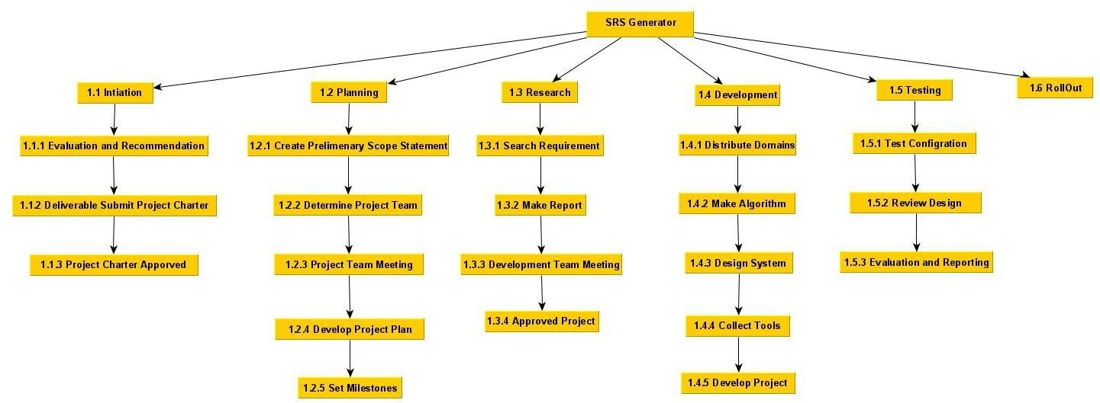
WORK BREAKDOWN STRUCTURE:
.

Slide 5
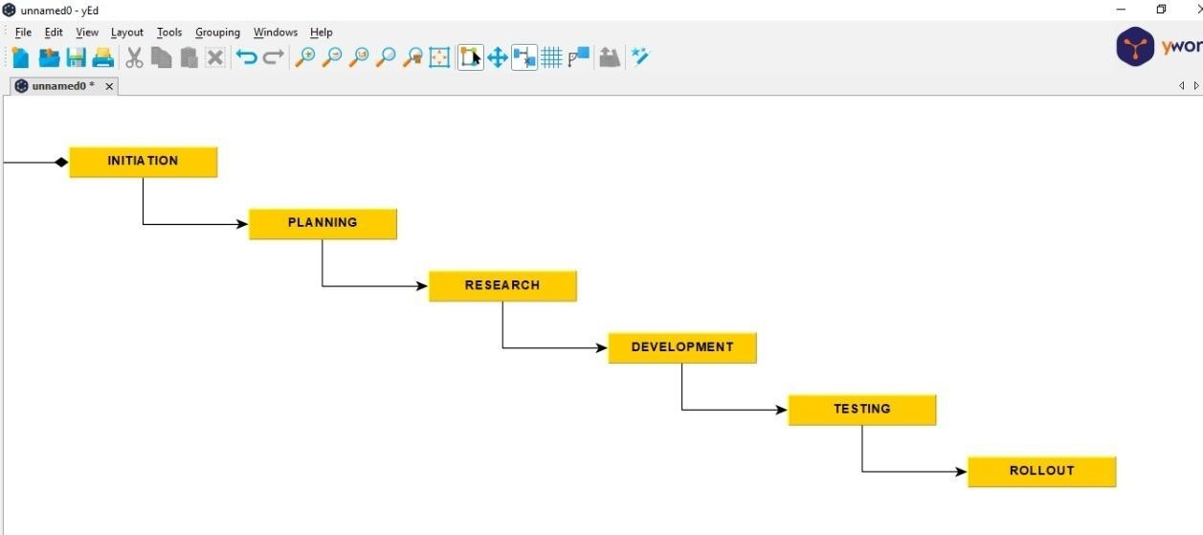
PROCESS MODEL:
.

Slide 6
PROCESS MODEL:
We are using the WATERFALL MODEL.
Why the model here?
1. Requirements are clearly understood.
2. There are simple and have well known criteria.
3. At the outset, we know all the specifications.
4. It is difficult to run processes in parallel.
5. No daily updates are needed.

Slide 7
SOFTWARE SYSTEM ATTRIBUTES:

Slide 8
RELIABILITY:
Reliability in the SRS Document Generator will be ensured by thorough milestone and release testing. The delivered source code will be tested through thorough scenarios. Testing will be ensured by complying with the generated user cases. Comprehensive test scenarios and acceptance criteria will be established to reflect the necessary level reliability required of the SRS Document Generator.

Slide 9
SECURITY:
The SRS Document Generator will maintain security by ensuring User login. The users who wish to login to the system must enter the valid credentials to get granted to login to the system. It will ensure that the new users’ data is kept encrypted. Software security is designed and used to protect computer programs against deliberate and other hacker attacks. This system’s software security is necessary as it allows to provide integrity of the system, user identification, and data availability.

Slide 10
MAINTAINABILTY:
Maintainability is the ease at which something can be maintained or restored to its functioning state. It determines how easy it is to isolate bugs or problems within a system and perform the repair. Maintenance can impact maintainability directly by shortening the MTTR. This could be achieved through training; knowledge transfers, creating standardized procedures and checklists in your CMMS, creating best practices for troubleshooting, having the right tools on site, and re-coding repair history in your CMMS to review later. As many of these actions can be tracked in Fix, it can play a large part in improving maintainability. The Accounting software is easy.

Slide 11
PORTABILITY:
As the SRS Document Generator works on the source code which is written in NodeJs and MongoDB, it could be extended and can be used further to make an App if needed. Hence the system has a great range of portability, the software could be ported into any other software. Significant changes to the SRS generator software may be required to ensure proper execution on other system platforms.

Slide 12
SOFTWARE REQUIREMENTS:
Frontend:
JavaScript
HTML CSS
Backend:
NodeJs
Database:
MongoDB

Slide 13
DESIGN APPROACH AND DETAILS:

Slide 14
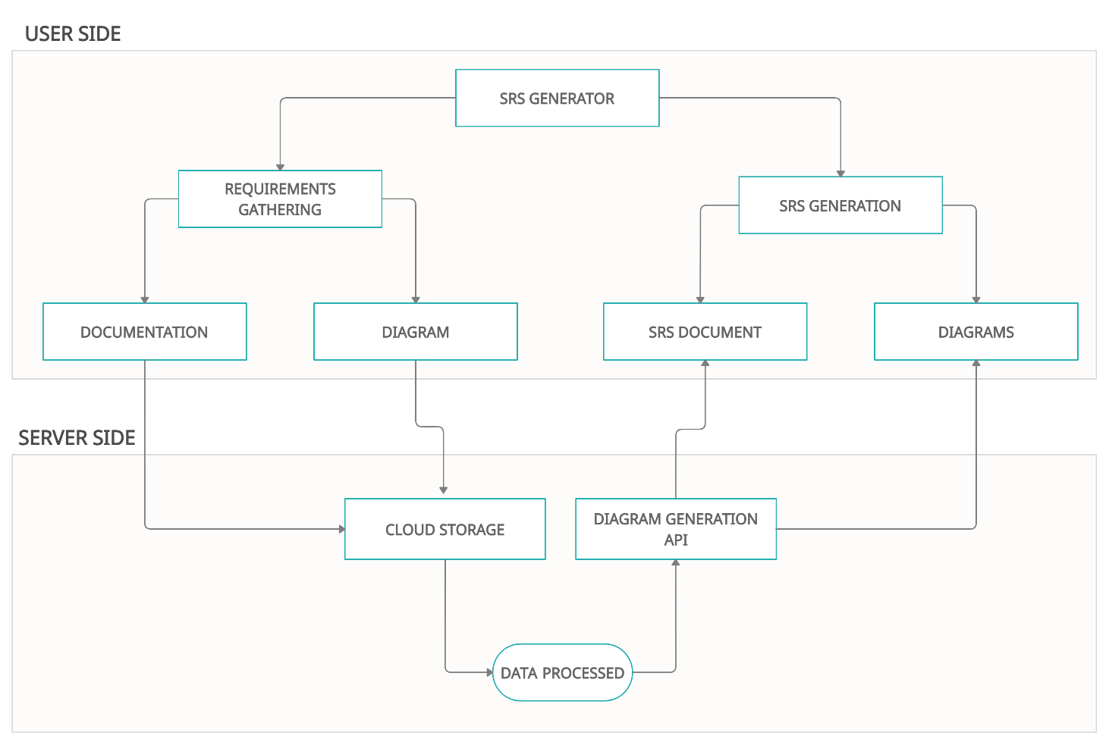
ARCHITECTURAL DESIGN:
.

Slide 15
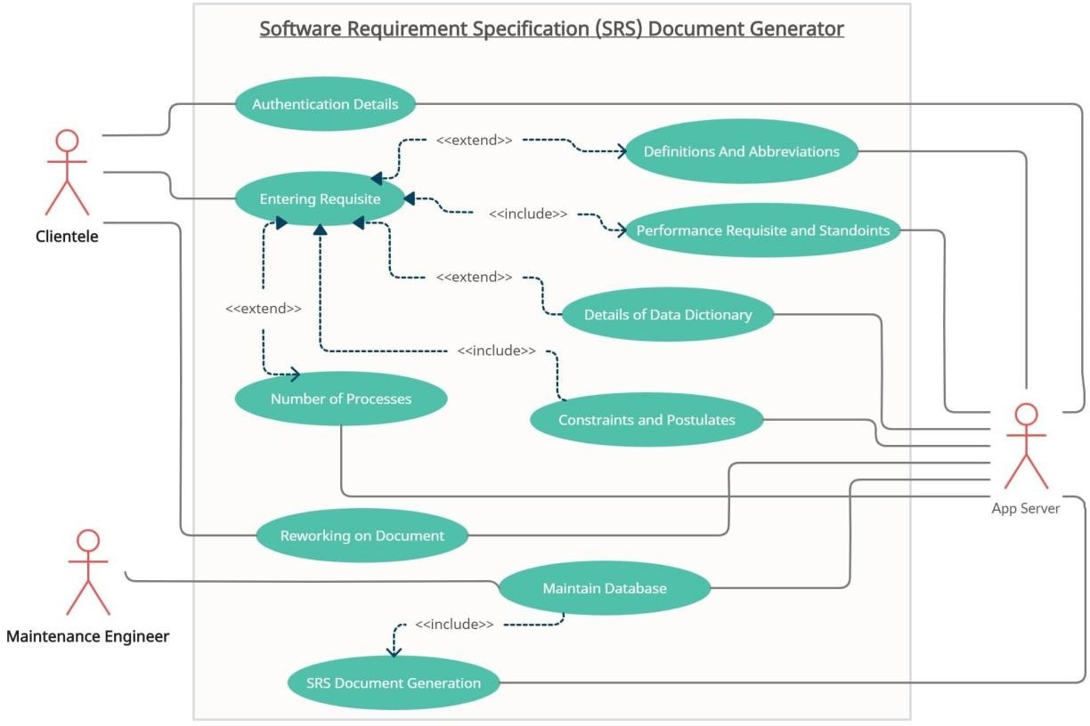
USECASE DESIGN:
.

Slide 16
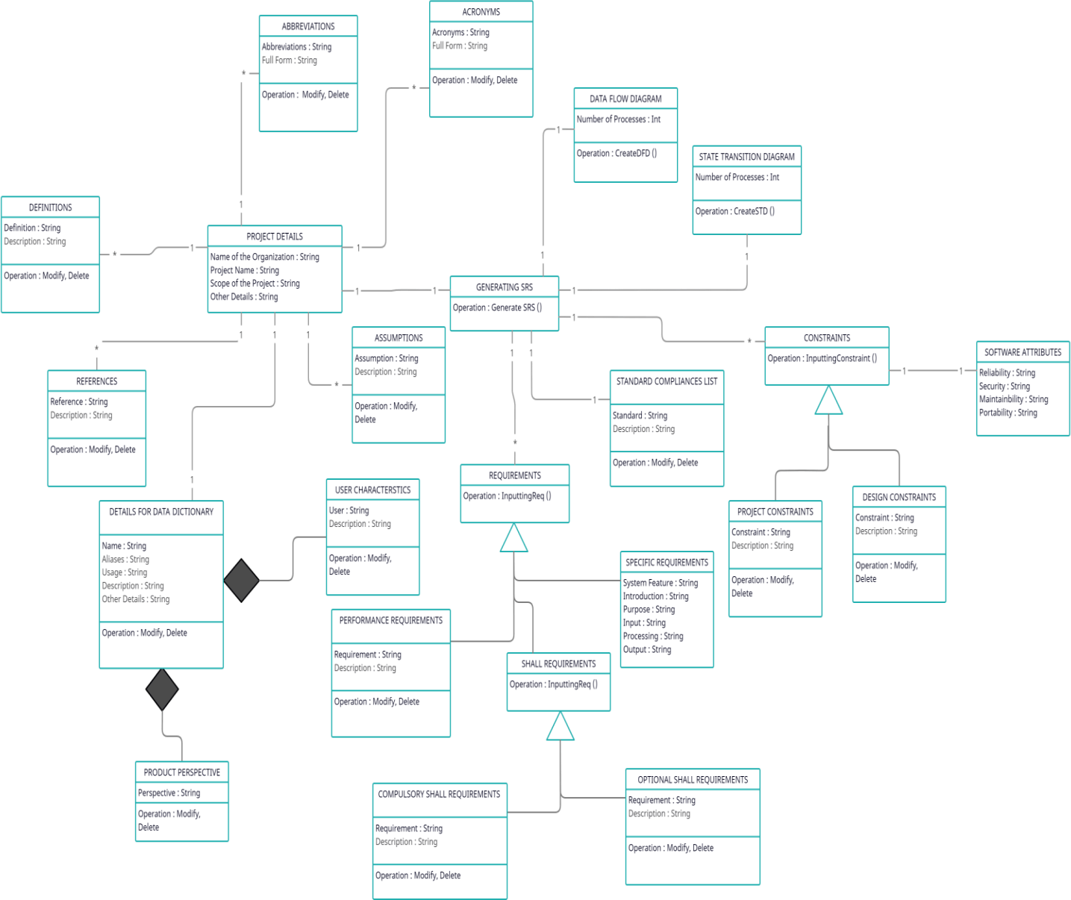
CLASS DIAGRAM:
.

Slide 17
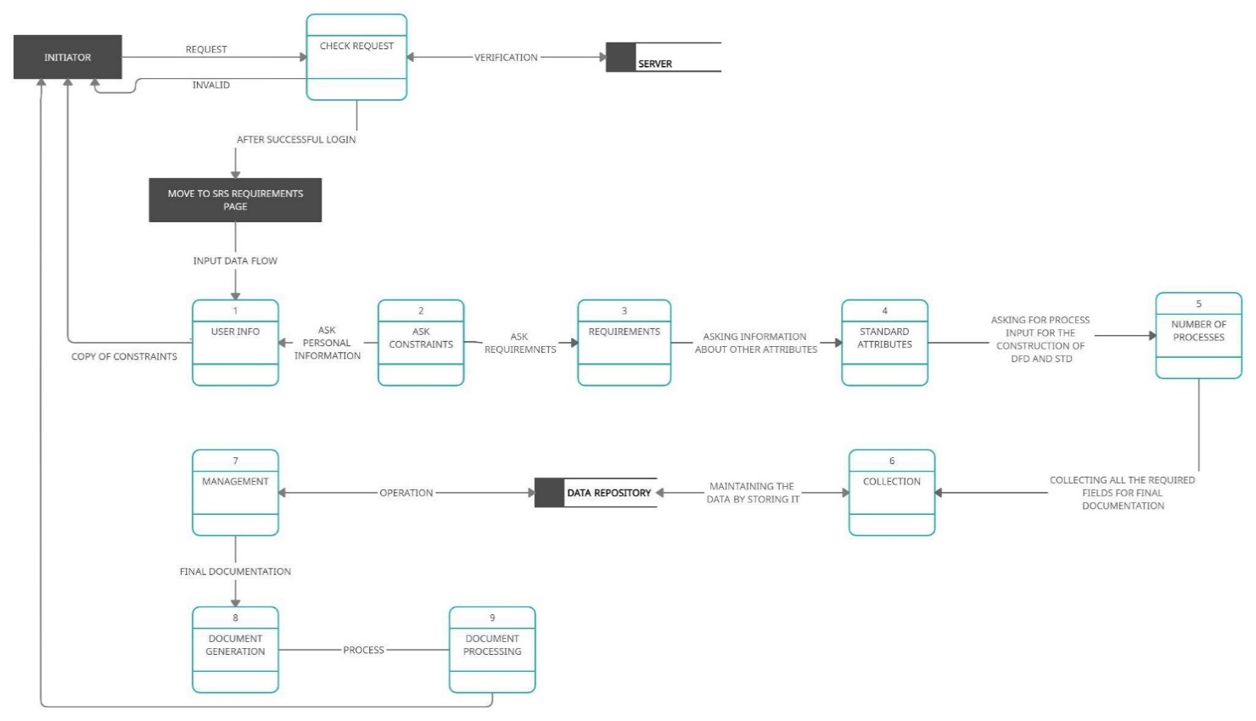
DATAFLOW DIAGRAM:
.

Slide 18
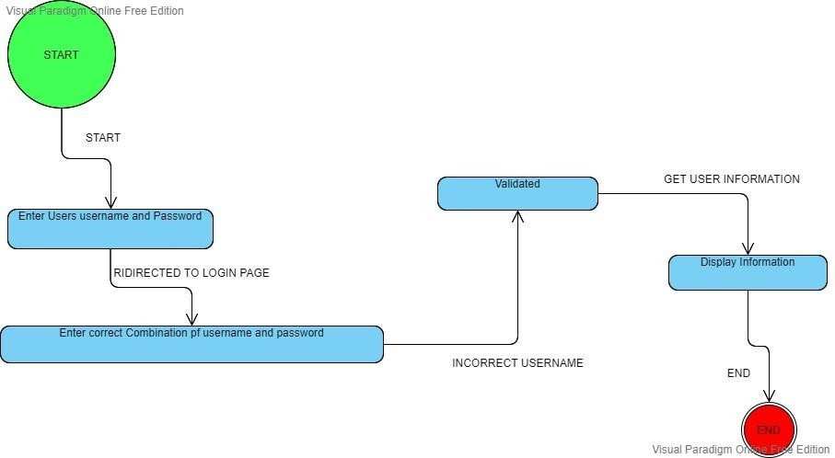
STATE TRANSITION DIAGRAM:
.

Slide 19
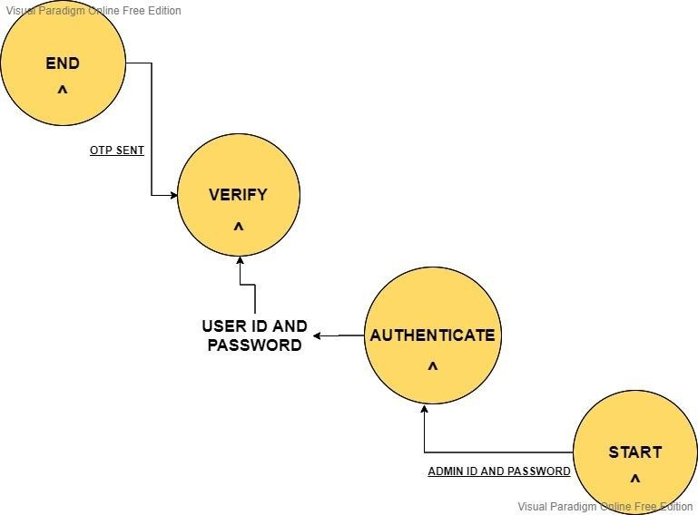
.

Slide 20
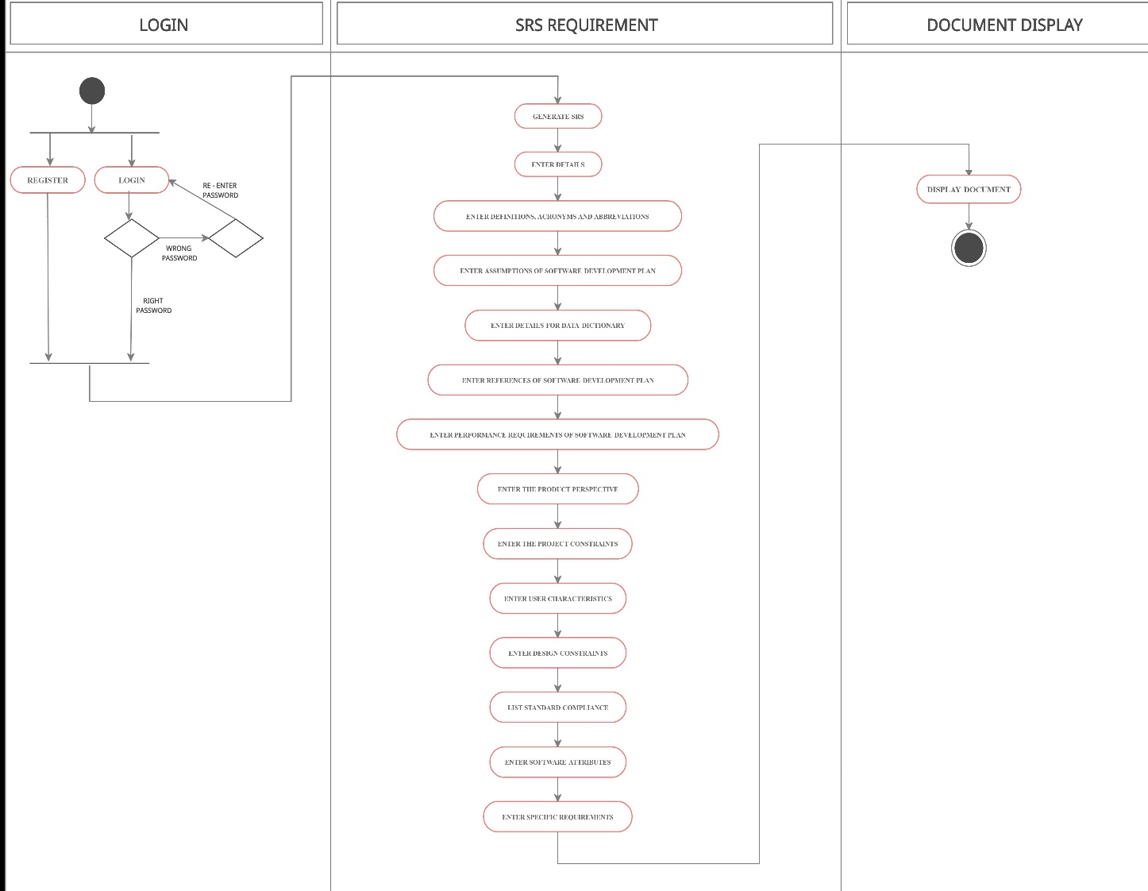
SWIMLANE ACTIVITY DIAGRAM:
.

Slide 21
SEQUENCE AND COLLABORATION:

Slide 22
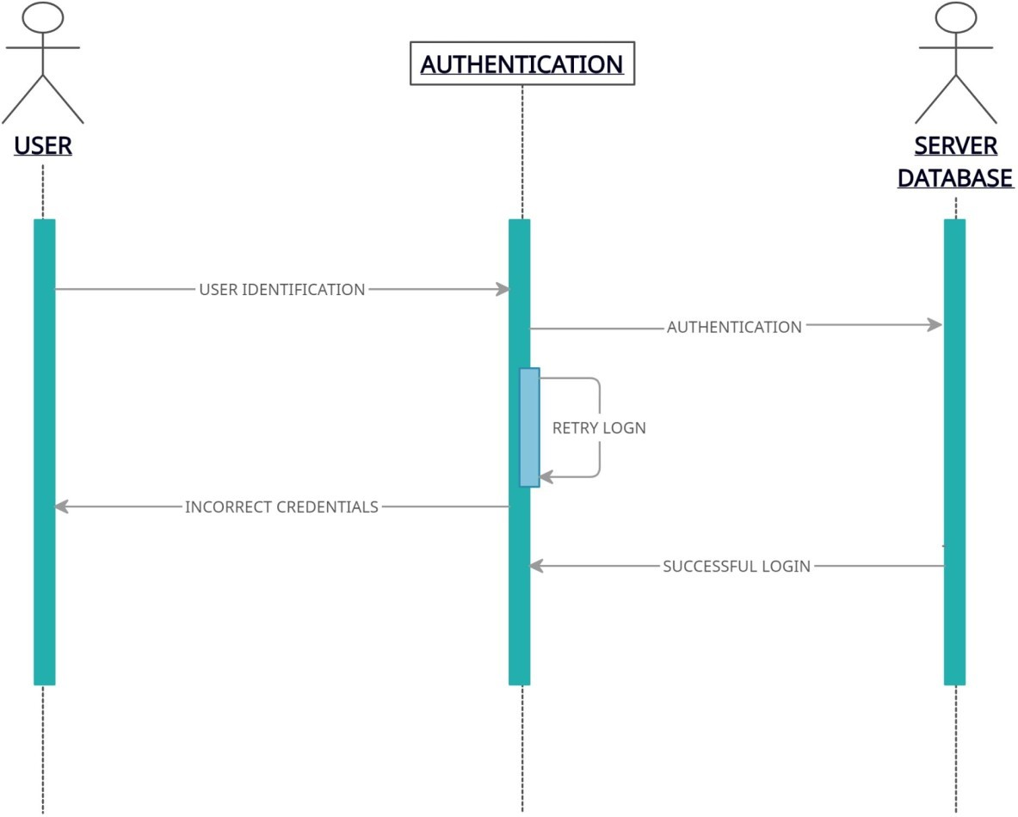
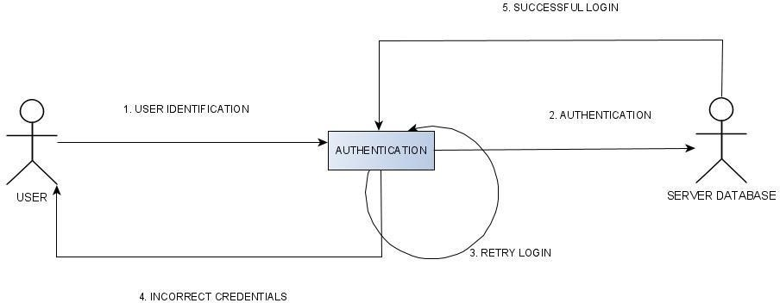
AUTHENTICATION DETAILS:
.

Slide 23
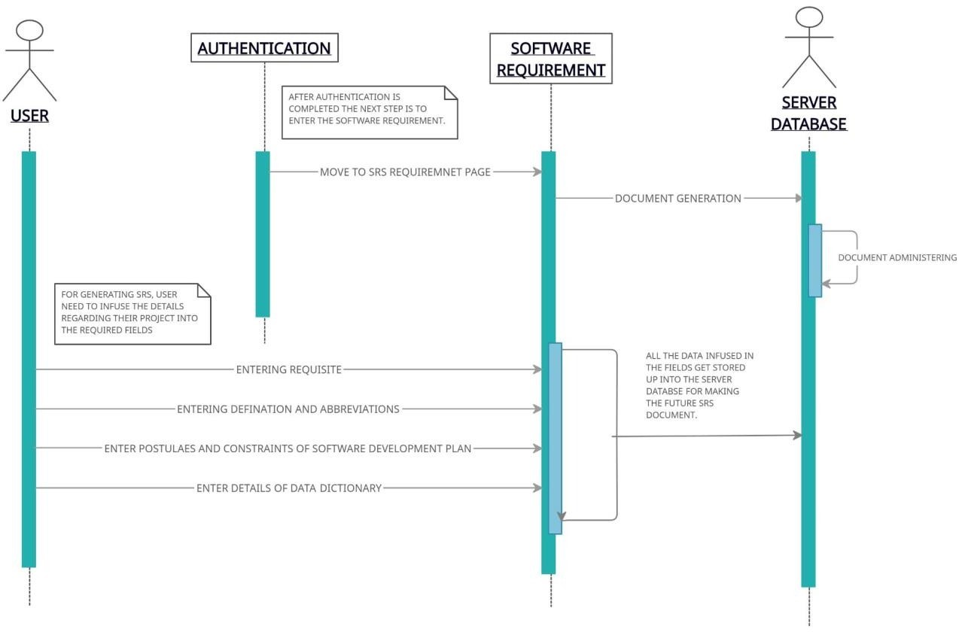
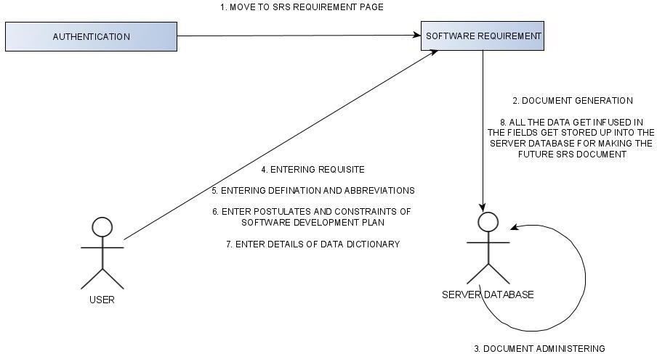
SRS REQUIREMENT:
.

Slide 24
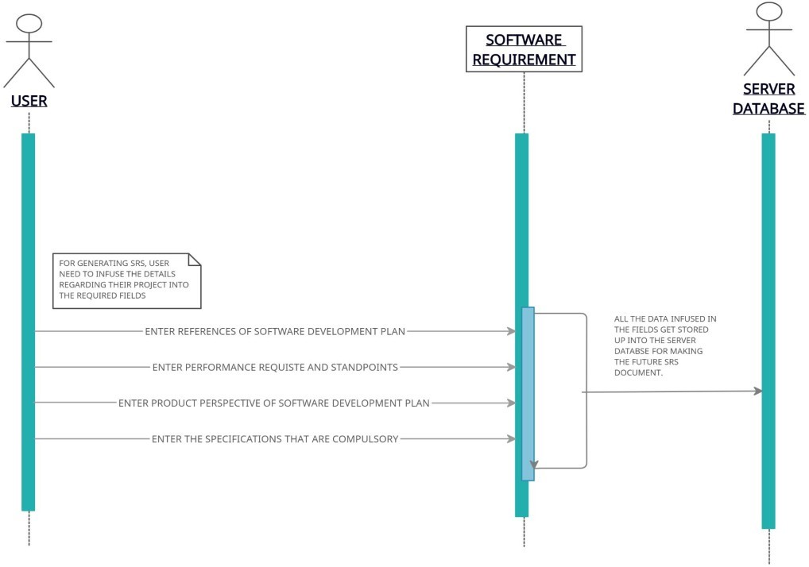
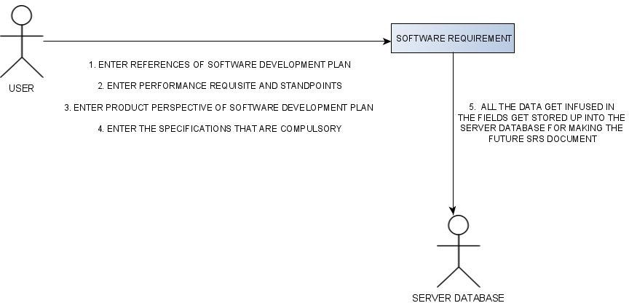
SOFTWARE DEVELOPMENT PLAN:
.

Slide 25
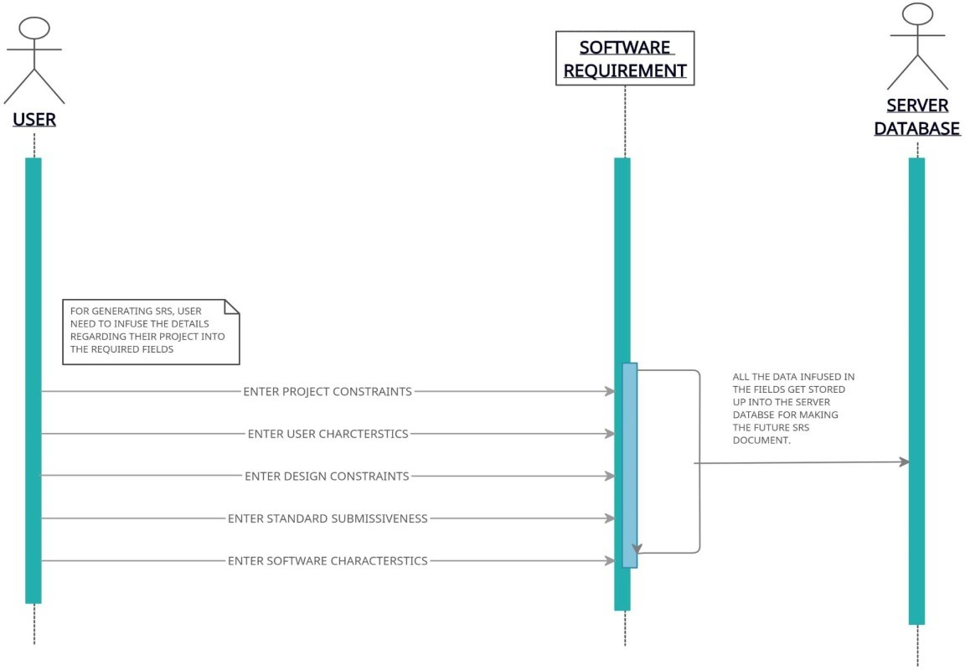
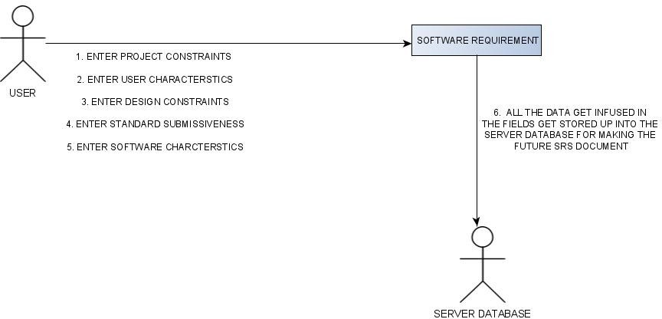
PROJECT AND DESIGN CONSTRAINTS:
.

Slide 26
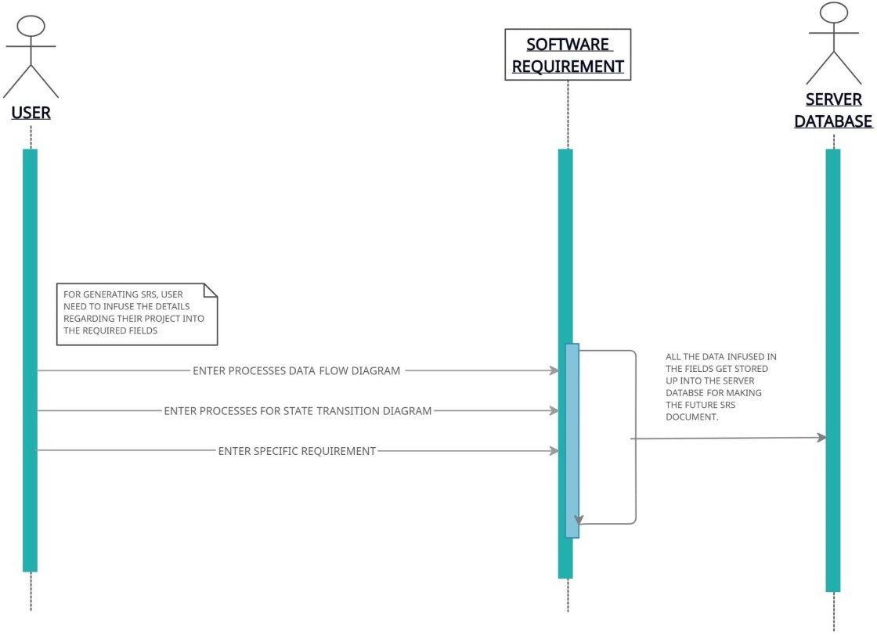
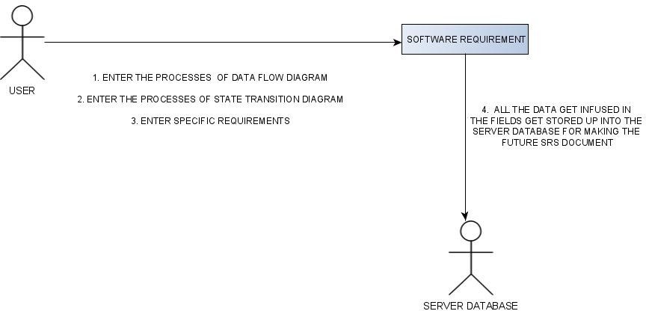
GENERATION AND DATA FLOW AND STATE TRANSITION:
.

Slide 27
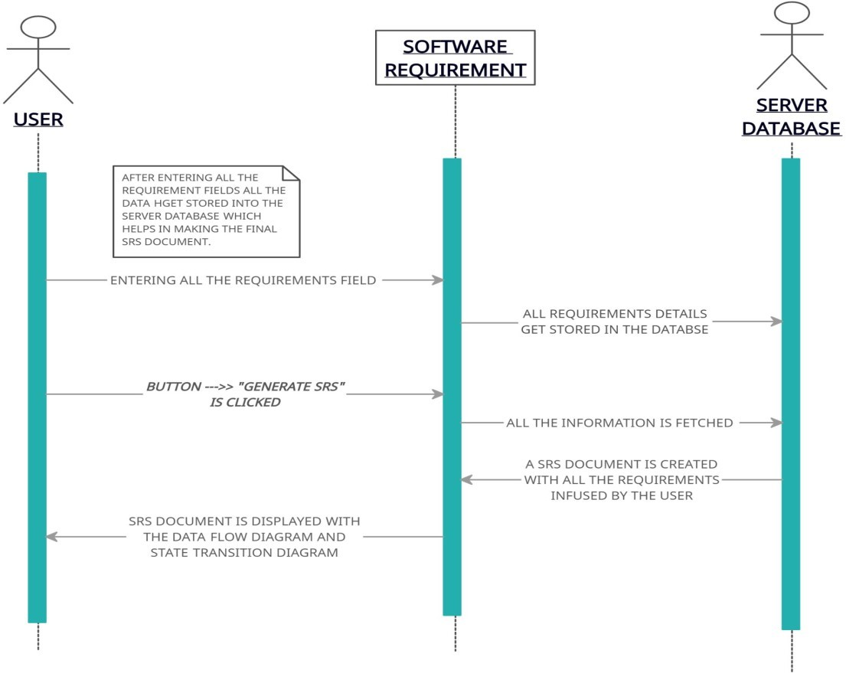
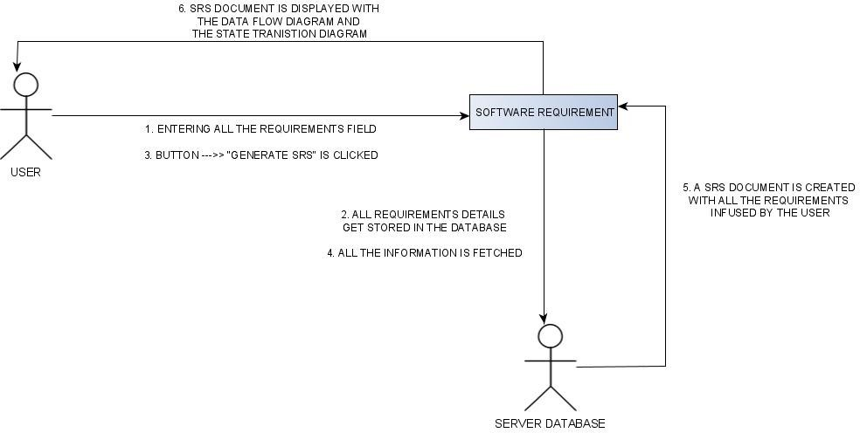
PROCESSING REQUIREMENT:
.

Slide 28
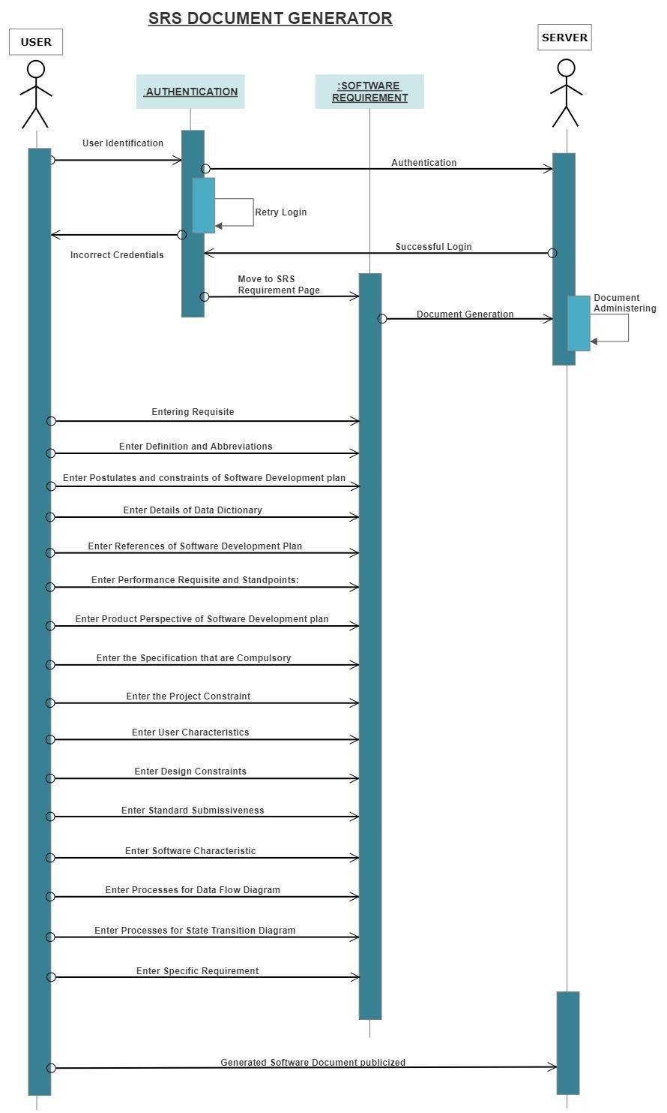
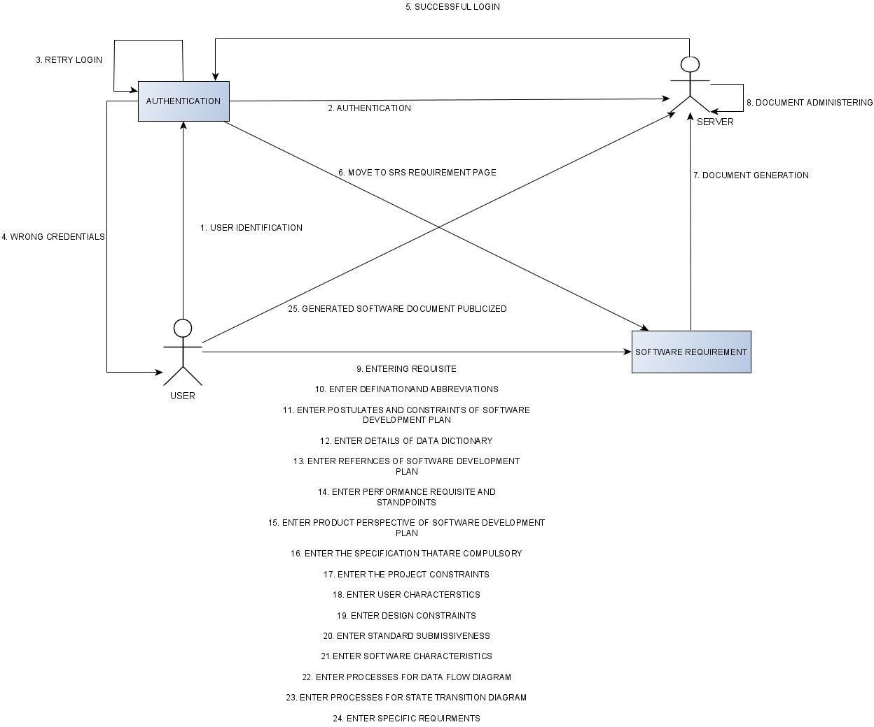
FULL SEQUENCE AND COLLABORATION:
.

Slide 29
TRADEOFFS:
Software developers usually have to make srs documents on a regular bases to make their work efficient and more presentable, for that we came up with this SRS document generator which will help them increase their work efficiency and productivity by saving their time.
The developers can't put in the required time to build the complete document from scratch, so we came up with this web based SRS DOCUMENT GENERATOR which will help them make their SRS DOCUMENT with the help of the their requirements which they input to the website.
.

Slide 30
SCHEDULED TASKS AND MILESTONES:

Slide 31
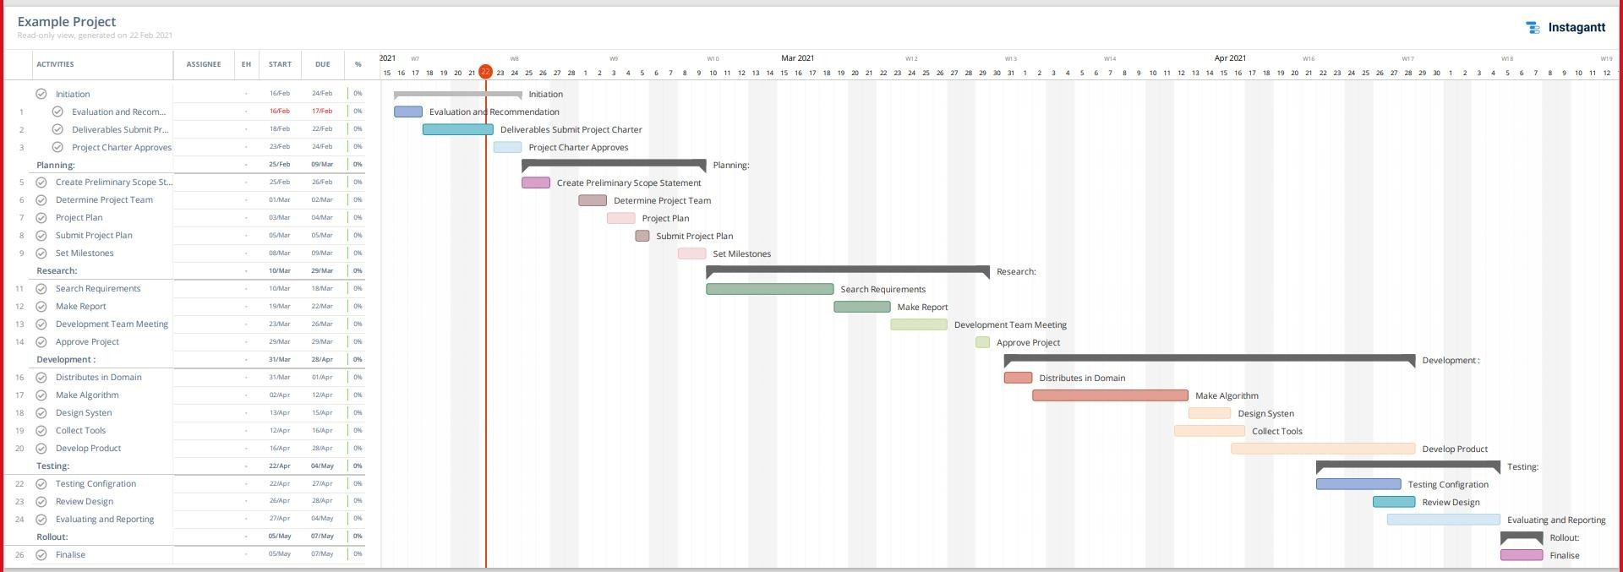
GANTT CHART:
.

Slide 32
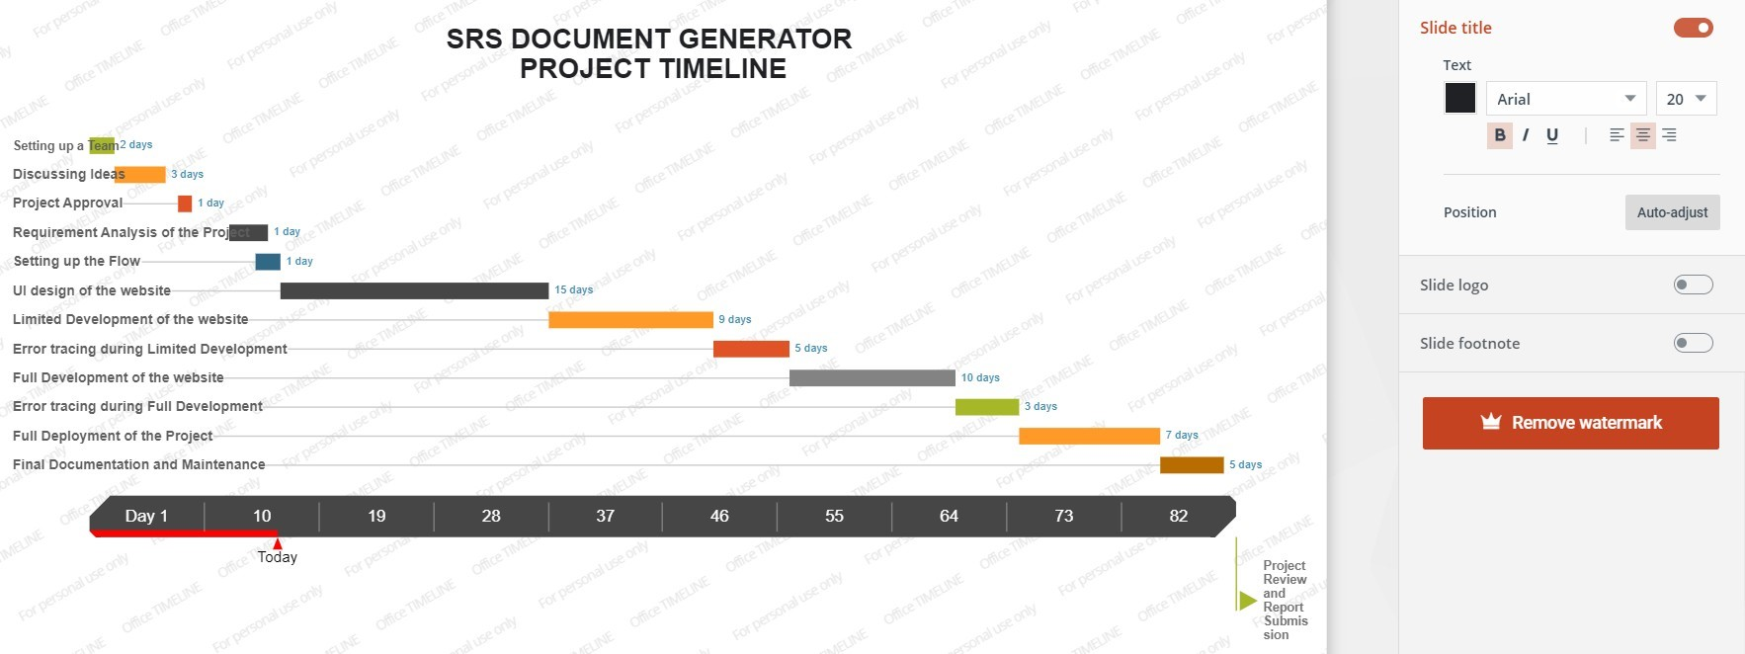
TIMELINE CHART:
.

Slide 33
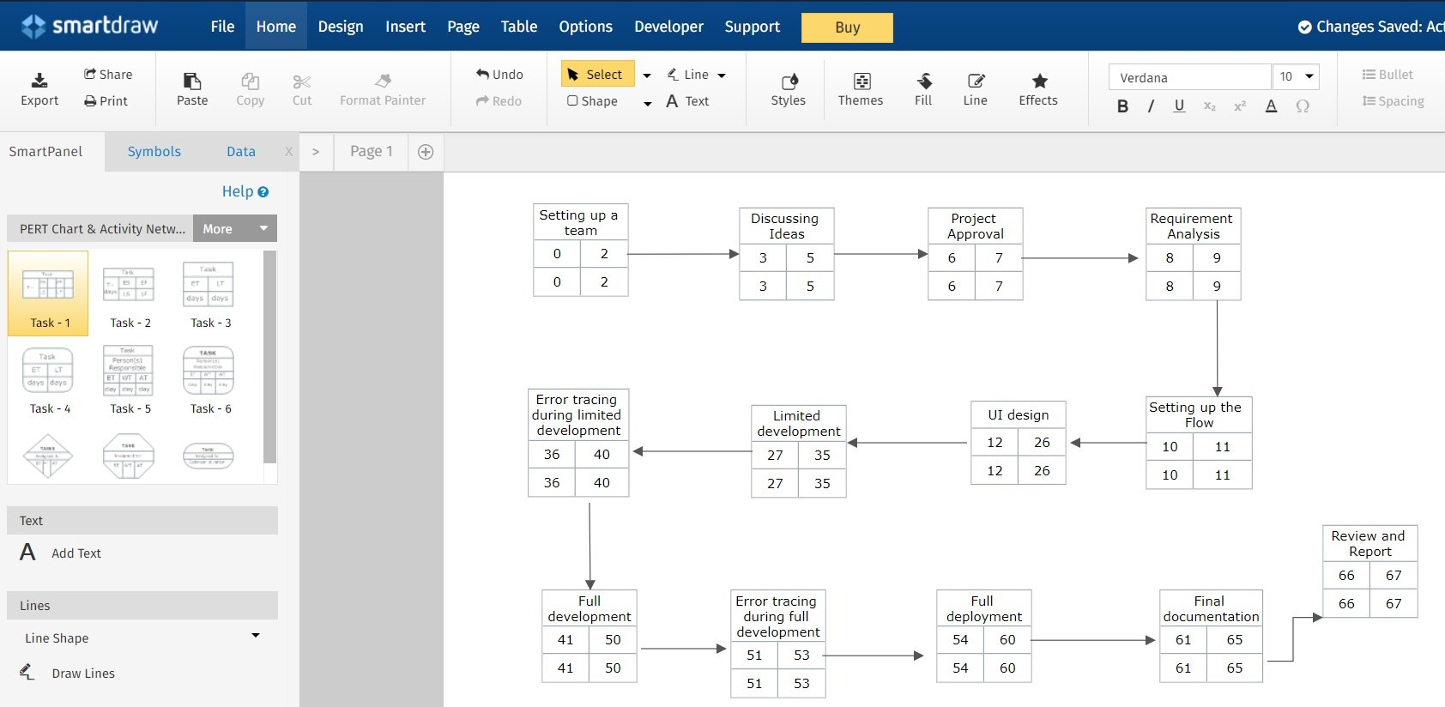
ACTIVITY CHART:
.

Slide 34
ACTIVITY CHART:
TASK | LABEL | PREDECESSORS | ESTIMATION DURATION
Setting up a team | A | - | 2 days
Discussing ideas | B | A | 3 days
Project Approval | C | A,B | 1 day
Requirement Analysis | D | A,B,C | 1 day
Setting up the flow | E | A,B,C | 1 day
UI Design | F | A,B,C,D | 15 days
Limited development | G | A,B,C,D,E,F | 9 days
Error tracing during limited development | H | A,B,C,D,E,F,G | 5 days
Full development | I | A,B,C,D,E,F,G,H | 10 days
Error tracing during full development | J | A,B,C,D,E,F,G,H,I | 3 days
Full deployment | K | A,B,C,D,E,F,G,H,I,J | 7 days
Final documentation and Maintenance | L | A,B,C,D,E,F,G,H,I,J,K | 5 days
.

Slide 35
RESULT AND ANALYSIS:
Our problem statement was to create a software that makes the SRS generation and documentation easier for project developers. To free people from the hassle of constructing the whole document from scratch, we have developed a web based App which will generate the SRS document, which will cover the data of all the stakeholders of the project, their requirements, constraints and assumptions and also cover the expected flow of work. It will also include Data Flow Diagrams, State Transition Diagrams and Entity Relationship Diagram according to their relevance to the project. The generated SRS document can be re-edited if the user wants to.

Slide 36
FUTURE WORK:
Currently once the user generates their document and saves it and subsequently closes it, the document is removed from memory. In future, the feature can be provided for saving all your previous SRS documents on your account, wherein all the SRS documents that a user has made till now will be saved. Additionally, instead of just one simple login as is present currently, two-factor authentication can be provided so that the SRS documents of the user will have better protection. Currently the document can be saved as an HTML page, and in case the user wants to save it, he or she has to copy and paste the contents of the document. In future, a feature can be provided to the user for downloading it in multiple formats, or to mail it to their email IDs, which will be editable once the user downloads it on their system.

Slide 37

THANK YOU!

